Slide 1
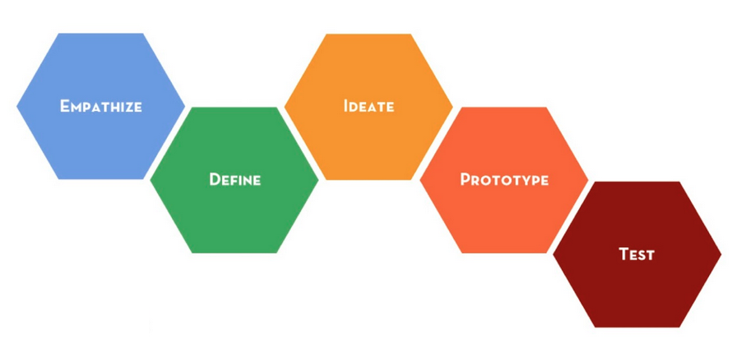
Design Thinking
Respect, Ownership and Integrity
Name(s):
Topic/Title:

Slide 2
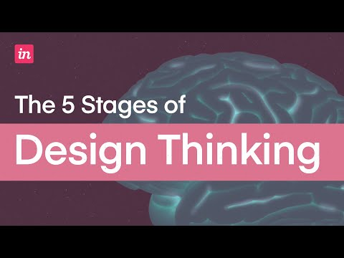
Click image for video link

Slide 3
Explore / Identify the Problem
Design thinking is about finding solutions to problems, so start by identifying a problem to solve.
Produce your questions.
Ask as many questions as you can.
Do not stop to discuss, judge, or answer the questions.
Write down every question exactly as it is stated.
Change any statement into a question.
Improve your questions.
Categorize questions as closed or open-ended.
Name the value of each question.
Prioritize your questions.
Choose the one important questions.
Identify next steps.

Slide 4
Empathise
Learn about your audience for whom you are designing a solution, and identify all possible viewpoints of your issue. Who are my users, and what matters to them?
Research
Explore the topic:
reading and reflection
observation
interaction
immersion in all perspectives and experiences
Identify:
all possible viewpoints
subjects you can interview
questions you can ask
topics to explore
background understanding needed

Slide 5
Define
Take a broad view, then narrow the lens of your search to bring clarity and focus to the problem. What needs to be solved? Who needs to hear about it? What point of view are you addressing?
Needs Statement
Create a needs statement or point of view that will drive your actions.

Slide 6
Ideate
Brainstorm ideas. Suspend judgment; think of the possible and the impossible, no idea is too far-fetched and no one’s ideas are rejected. Be creative and have fun; the more ideas the better!
Brainstorm Effectively
Assign a moderator - have someone to keep you on track.
Define goals - have a purpose for your session
Set a time limit - stick to the plan!
Visualize it - write down everything
Don’t judge - Embrace the ridiculous!
Combine and create - look for ways to fit together
Play devil’s advocate - consider alternatives of the obvious
Vote for the best idea.

Slide 7
Prototype
Here is where you create a product. This could be a model you build, a detailed diagram or plan, a letter, a process, an art piece, a story, a role-play … whatever brings form to your ideas.
How to Prototype
Just Start! - Pick up some kind of material and just start building, doing, writing, sketching, or making!
Build with the user in mind - Are you meeting the true needs of the users, based on empathy, and how?
Create a “to do” list - Help every team member contribute and stay on task.
Never give up - Push through and do not give up, even if you get stuck. If necessary, go back and IDEATE some more!
Think outside the box - Look for non-traditional ways to do something.

Slide 8
Test and Evolve
Here you see if your prototype satisfies the users’ needs, and if not, what changes need to be made. Testing is about making things better; “failure” is really just an opportunity for more growth!
How to Test Your Prototype
Show Don’t Tell - Put it in the hands of others and have them experience it (historical simulations, character experiences, products)
Watch and Learn - Watch reactions and note responses to grow your prototype.
Ideate and Prototype Again - if things don’t work the first time, take the opportunity to learn and improve your ideas.
Be Qualitative and Quantitative - Consider different measures of effectiveness; consider the context of the test and needs of the user.

Slide 9
Reflect
The most important learning of any inquiry comes in the reflection. What did you learn? Consider the process as well as the product as you reflect on your learning and prepare for future inquiries.
Guided Reflection Questions
What part of the project was difficult and why?
What strategies did you employ to overcome obstacles?
What are the parts of the design process that remain unclear or you have questions about?
What would you share with the users for whom you developed the solution?

